Slide 1


Health Promotion and Population Health: Working Together
Alex MacKinnon MHST 631

Slide 2
Definitions
Population Health: Overall Health (Mikkonen & Raphael, 2010)
Health Promotion: Empowering people and their communities (World Health Organization, 1986)
Population Health Promotion Model: Integrates the two, showing how to act on determinants (what), with Ottawa Charter strategies (how), across different levels of society (who) (Government of Canada, 2001).

Slide 3
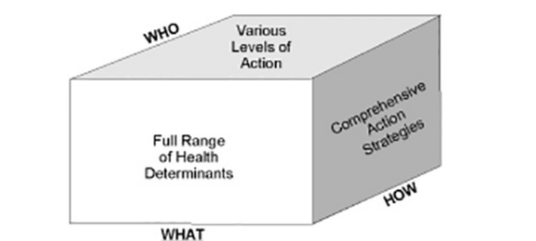
Population Health Promotion Model: How do they connect?
What: Act on the full range of social determinants
How: Using strategies from the charter
Who: Individuals to Communities
The Population Health Model shows the integration of population health and health promotion.
The cube demonstrates how we link determinants (what), strategies (how), and levels of society (who) into practice.

Slide 4
Virtual Care After Surgery
WHAT (Determinants of Health)
  Access to health services after discharge.
  Health literacy making sure patients understand medications, wound care, and warning signs.
  Support networks ensuring patients and families feel safe and connected at home.
HOW (Comprehensive Action Strategies):
  Develop Personal Skills: Nurses teach patients how to manage recovery and spot complications.
  Create Supportive Environments: Technology and follow-up calls provide reassurance and reduce isolation
  Reorient Health Services: Care shifts from reactive hospital visits to proactive monitoring at home.
WHO (Levels of Action):
  Individual: Patients gain confidence in managing their recovery.
  Family/Community: Families are included in education and care planning, creating a support system.
  Health System/Society: Reduced readmissions free up acute care resources and contribute to more sustainable health care.
Surgical patients who are discharged and monitored virtually for optimal recovery!

Slide 5

References
Government of Canada. (2001) Population Health Promotion: An Integrated Model of Population Health and Health Promotion https://www.canada.ca/en/public-health/services/health-promotion/population-health/population-health-promotion-integrated-model-population-health-health-promotion/developing-population-health-promotion-model.html
Mikkonen, J., & Raphael, D. (2010). Social determinants of health: The Canadian facts. York University School of Health Policy and Management.
World Health Organization. (1986). Ottawa charter for health promotion, 1986 (No. WHO/EURO: 1986-4044-43803-61677). World Health Organization. Regional Office for Europe. https://www.canada.ca/content/dam/phac-aspc/documents/services/health-promotion/population-health/ottawa-charter-health-promotion-international-conference-on-health-promotion/charter.pdf

