Slide 1
Systematic
Reviews
MHST 632 Health Promotion
Alex MacKinnon

Slide 2
Learning Outcomes
Define what a systematic review is
Identify when a systematic review should be used
Describe key steps in conducting a systematic review
Explain how systematic reviews are reported

Slide 3
What is a systematic review
The highest level of evidence synthesis when done correctly
Follows predefined, transparent methodological steps
Goal is to minimize bias and make the process reproducible
Preferred Reporting Items for Systematic Reviews and Meta-Analyses
  Systematic framework for transparent reporting
  Requires reporting search strategy and selection decisions

Slide 4
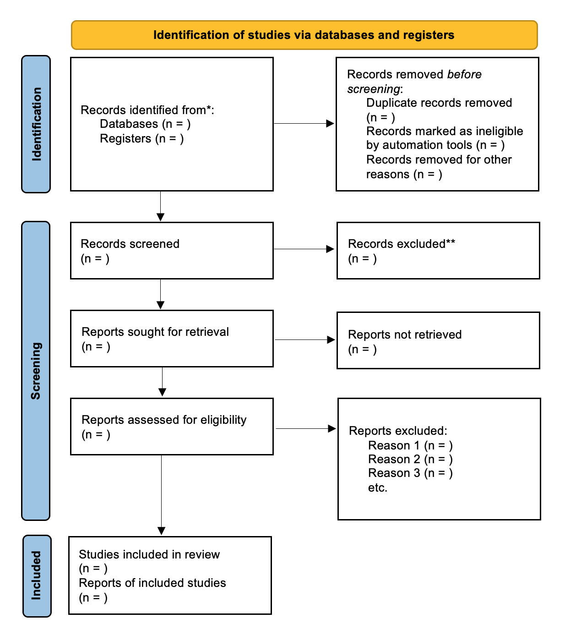

Slide 5

When should you use a systematic review?
When you have a clear, answerable question (e.g., intervention effectiveness, association, experiences).
When you want a comprehensive picture of what’s known (and what’s not).
When your goal is to guide practice/policy or justify a new research study.
When the topic has enough studies to compare and synthesize.

Slide 6

Formulate the research question

Slide 7
Asking yourself the right questions
Quantitative effectiveness questions with PICO
Population
Intervention
Comparison
Outcome
Qualitative or Experience-focused questions with SPIDER
  Sample
  Phenomenon of interest
  Design
  Evaluation
  Research type
Define the scope before searching primary outcomes + inclusion criteria
Example: Primary outcomes readmission reduction, health literacy improvement
Inclusion criteria: Age of patients, discharged from acute care hospital

Slide 8
How to conduct your search
Utilize databases that match your topic
Medline
PubMed
CINAHL
Use keywords and controlled vocabulary
Record and document all findings
Boolean logic: Using AND / OR
Truncation: educat*
Utilize databases that match your topic
Medline
PubMed
CINAHL
Clean your records though the PRISMA flow deduplicating articles
Evaluate study quality by looking for bias, quality tools

Slide 9
Extracting data
Create a data extraction table
Table would capture setting, sample, design measures etc.
Keep notes on the context, or the heart of the study
Article | Design | Setting | ​Sample
 | RCT​ | Urban hospital | 120​
 | Mix Method | Rural | 75​
 | Quasi​ | Trauma Center | 15​
​ | Analysis | Rural | 95​

Slide 10
Putting it all together
Narrative synthesis: Organize studies by themes, outcomes, or populations and compare what the studies found.
Meta-analysis: Statistically combine results when studies are similar enough to calculate an overall effect.
Qualitative synthesis : Combine themes from qualitative studies to understand shared experiences and meanings.
Consider heterogeneity: Always discuss important differences between studies (populations, methods, or settings) because these affect how results can be combined.

Slide 11
References
Linnenluecke, M. K., Marrone, M., & Singh, A. K. (2020). Conducting systematic literature reviews and bibliometric analyses. Australian journal of management, 45(2), 175-194.
Xiao, Y., & Watson, M. (2019). Guidance on conducting a systematic literature review. Journal of planning education and research, 39(1), 93-112.

